Slide 1
Description
Project 2 : WebChat

Slide 2
I would like to see …
Registration and authorization
Ability to create and view a user profile
Anonymous chat without specifying any data
Admissibility of leaving feedback for the siteСтраница разработчиков
Password change

Slide 3
Technology
Maven
Spring security
PostgreSQL
Git
JDBC
Servlets
Tomcat

Slide 4
Apache Maven
Apache Maven is a framework for automating the assembly of projects based on the description of their structure in files in the POM (Project Object Model) language, which is a subset of XML.

Slide 5
Spring Security
Spring Security - it is a framework that focuses on providing both authentication and authorization in Java applications. Like all Spring projects, its real strength lies in the fact that it can be easily extended with the necessary functionality.

Slide 6
PostgreSQL
PostgreSQL - free object-relational database management system (DBMS).

Slide 7
Git
Distributed version control system.

Slide 8
JDBC
JDBC (англ. Java DataBase Connectivity - соединение с базами данных на Java) - platform independent industry standard for interaction of Java applications with various DBMS.

Slide 9
Servlets
Servlet – first of all, it is a simple Java interface, the implementation of which extends the functionality of the server. The servlet communicates with clients through a request-response principle. While servlets can serve any request, they are commonly used to extend web servers.

Slide 10
Tomcat
Tomcat — an open source servlet container developed by the Apache Software Foundation. Implements the Servlet specification, the JavaServer Pages specification, and the JavaServer Faces specification. Written in Java. Tomcat allows you to run web applications and contains a number of self-configuring programs.

Slide 11
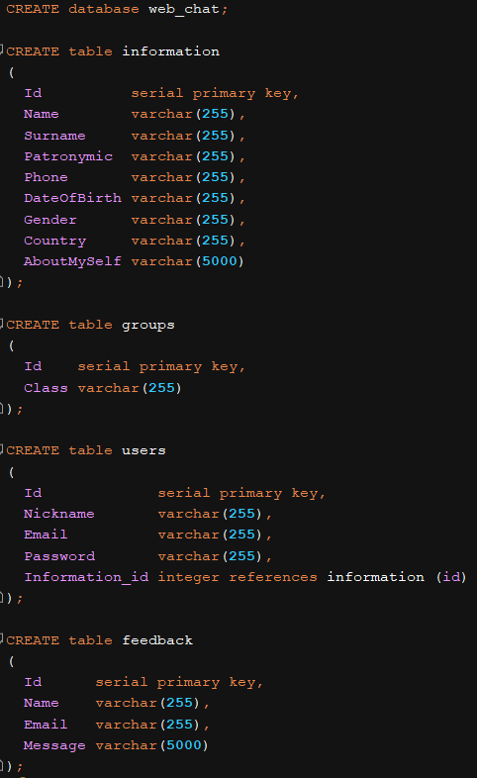
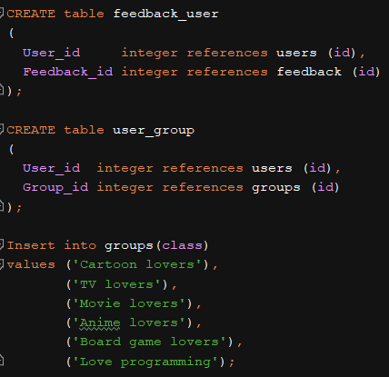
Tables

Slide 12
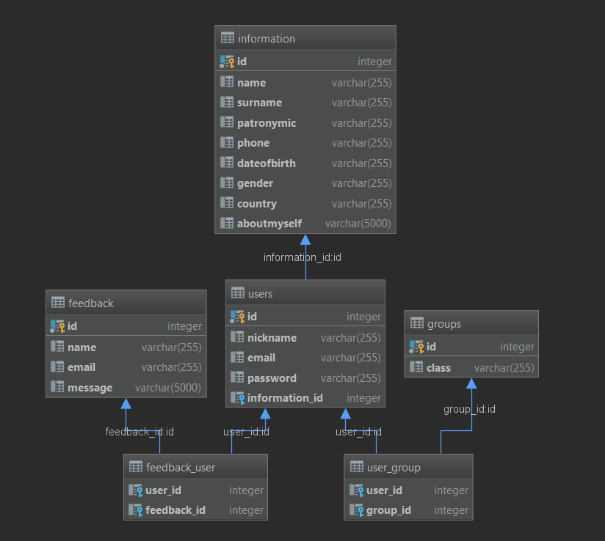
Database links

Slide 13
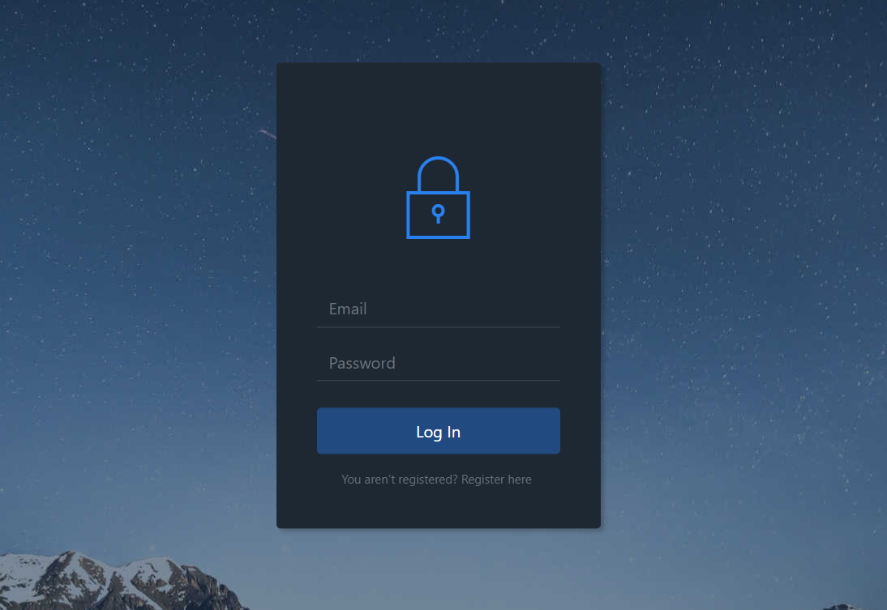
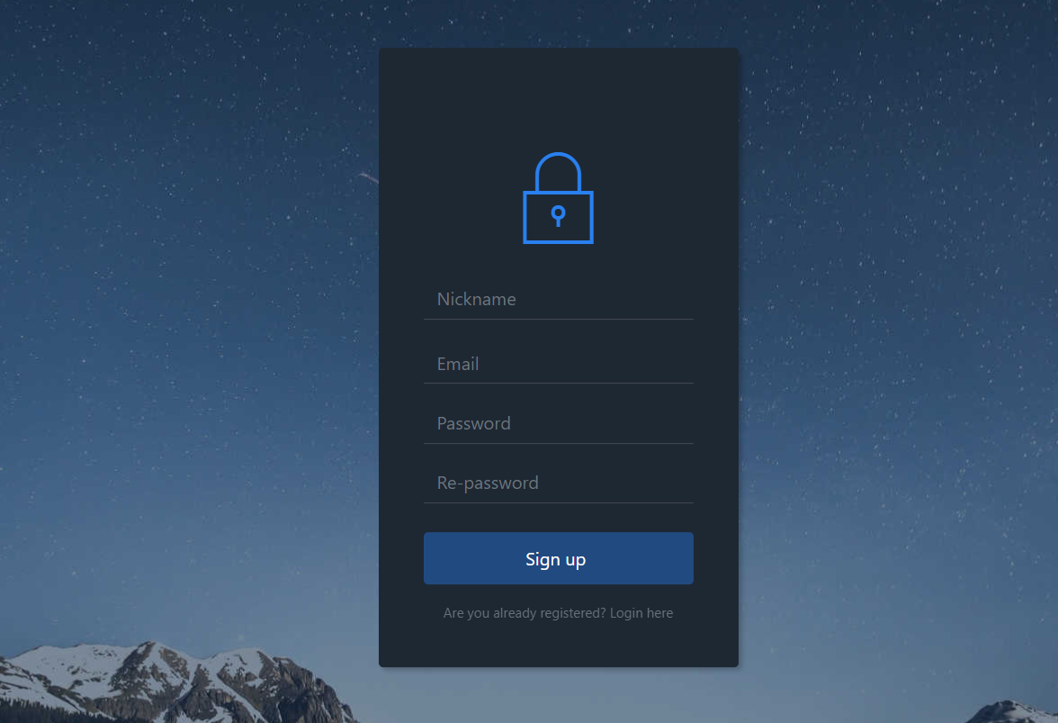
Authorization and registration

Slide 14
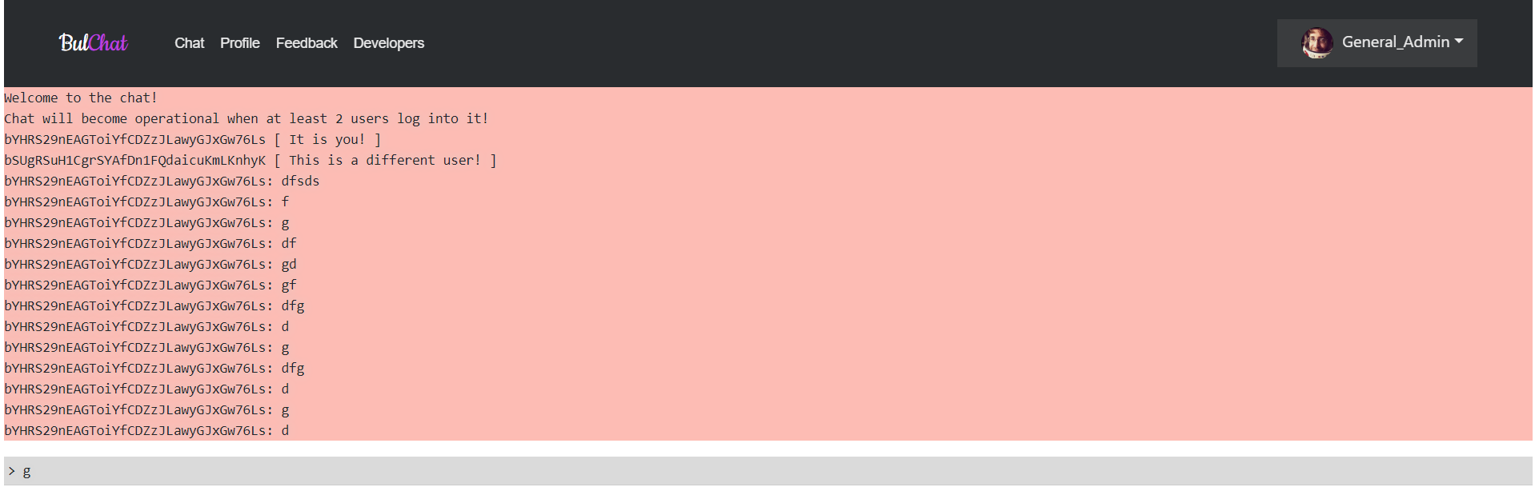
Chat

Slide 15
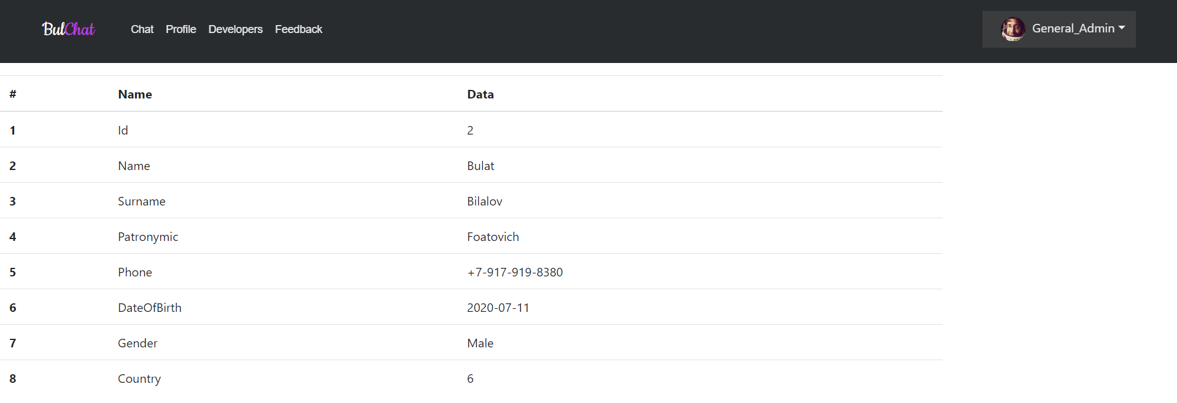
Profile

Slide 16
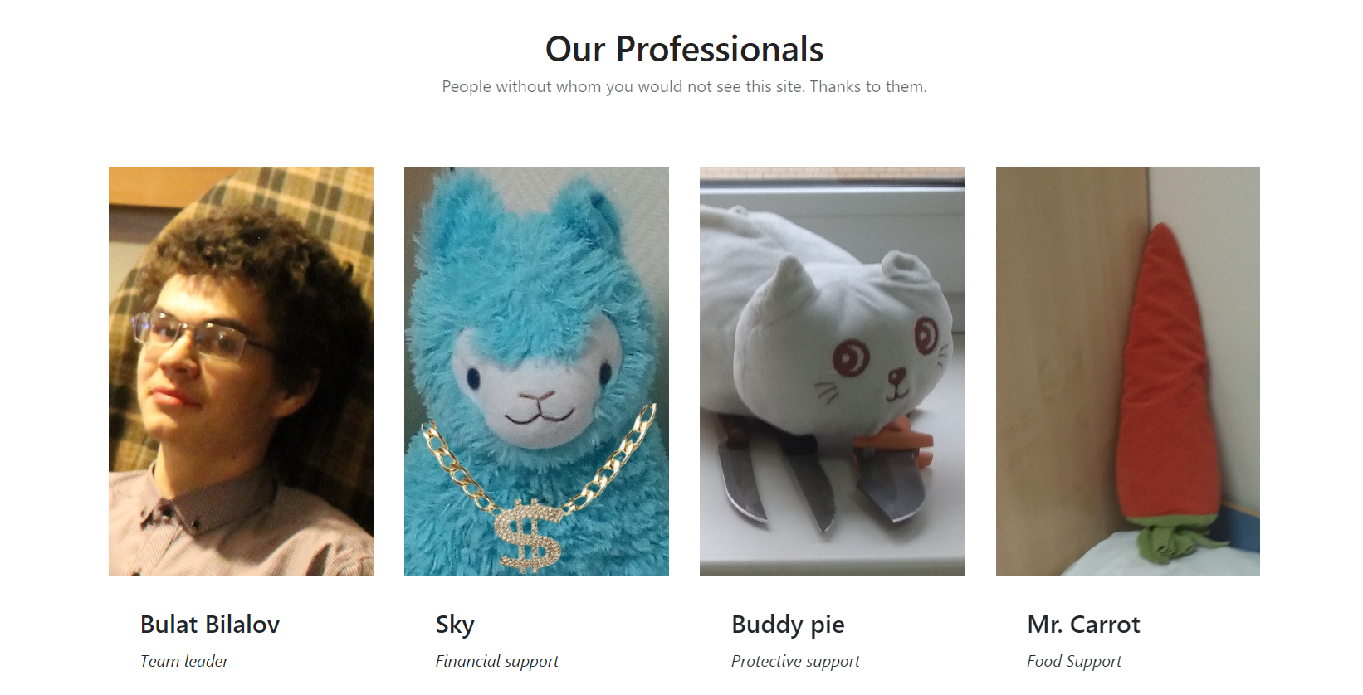
Developers

Slide 17
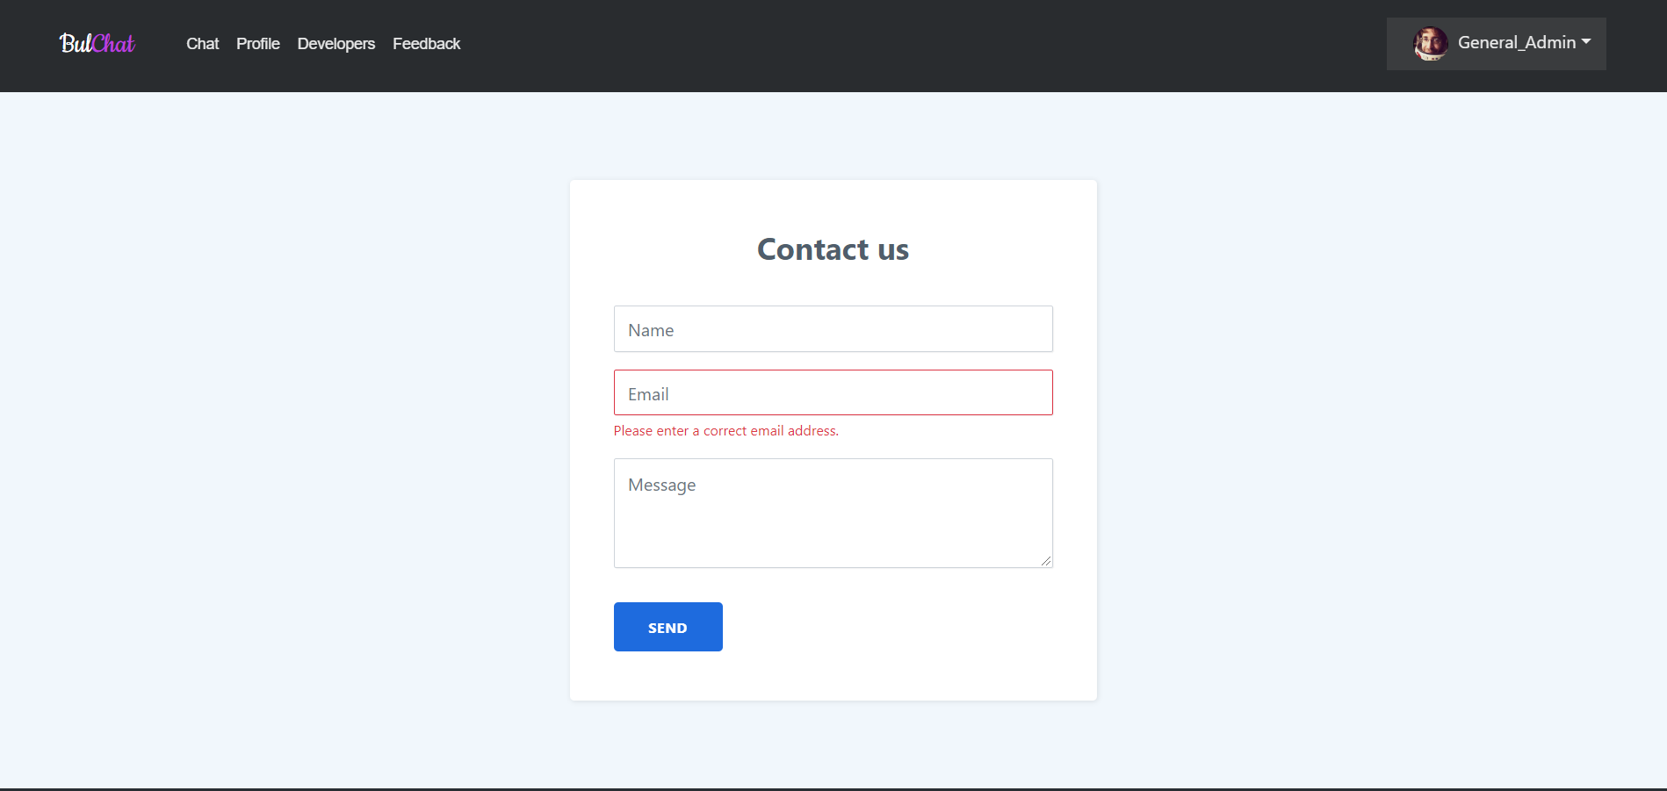
Feedback

Slide 18
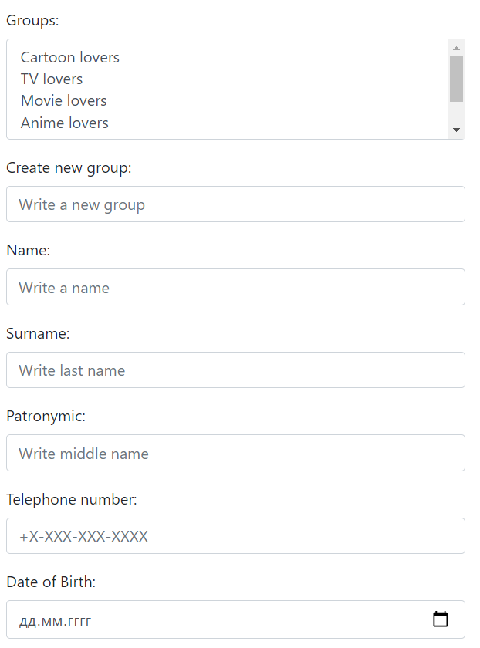
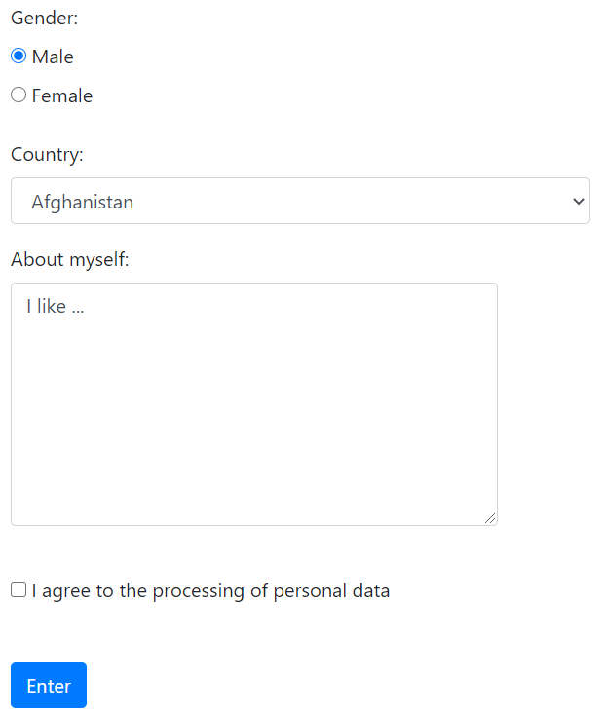

Slide 19
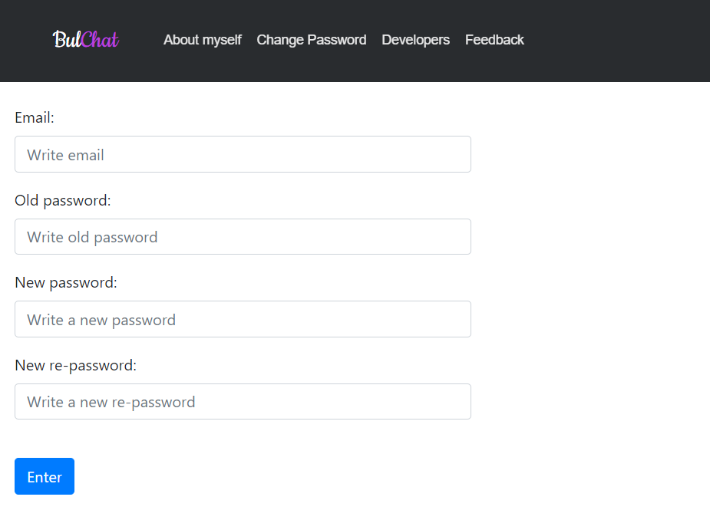
Change password

Slide 20
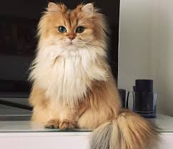
Thanks for your attention!

